Slide 1
Lambda Functions
Programming III

Slide 2
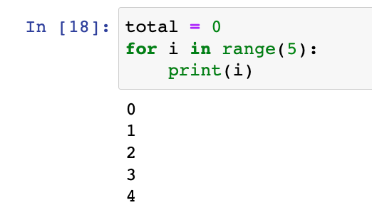
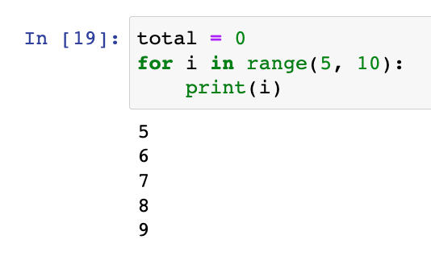
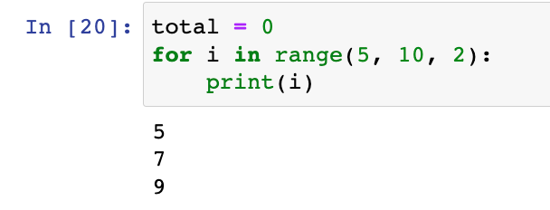
Range
You can use the standard library function range to get numbers between values
range(start, end, step)

Slide 3
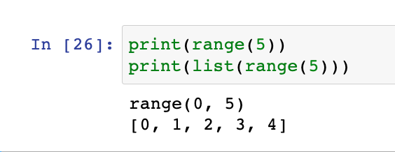
Range
range is an range object that is converted to a list of numbers
in a for loop, we iterate over the list of numbers

Slide 4
Review: Iterators
You can “iterate” or “loop” items in a collection
List Version 1
for item in my_list:
print(item)
List Version 2
for index in len(my_list):
print(my_list[index]) # This will print the exact same thing as Version 1
Dictionary
for key in my_dict:
print(“key: “ + key)
print(“value: “ + my_dict[key])

Slide 5
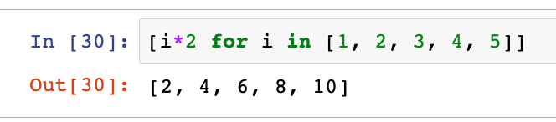
One-line for loop
We can execute a for loop in one line for simple operations
In this example, for each number in the list (i), multiply that number by two (i*2) and create a new list with the result

Slide 6
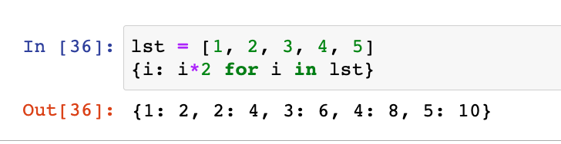
One-line for loop
We can execute a for loop in one line for simple operations
In this example, for each number in the list (i), multiply that number by two (i*2). Using i for keys (i:) and i*2 as the values, create a new dictionary with the result

Slide 7
One-line for loop
value
iterate over list
key

Slide 8
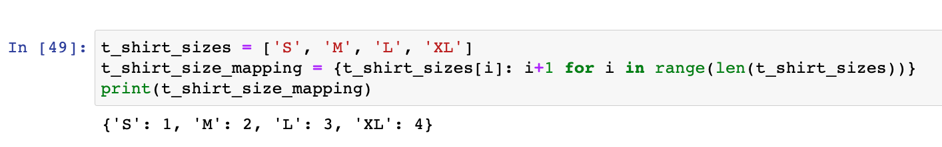
One-line for loop
This is useful for creating mappings

Slide 9
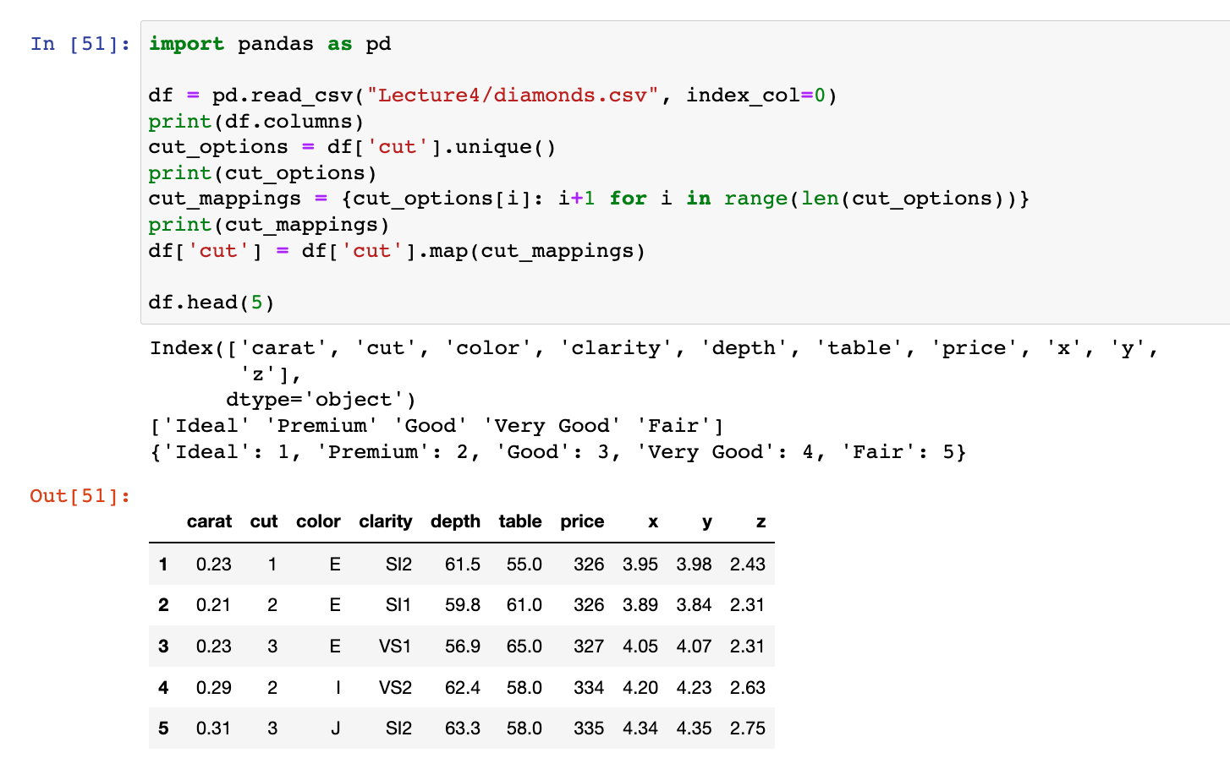
One-line for loop
Be careful when programmatically creating mappings because it may not be a good representation of the values.
Usually okay for nominal values (values with no order) but not ordinal values (values with order)

Slide 10
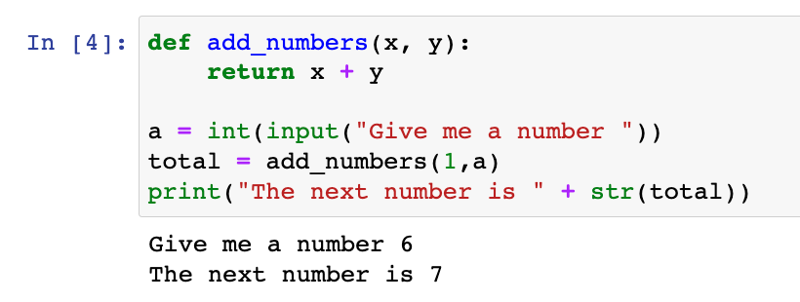
Review: Functions
Functions are snippets of code than can be called and executed multiple times
We define functions with the keyword def and give them a name.
They can take in values via parameters. These parameters can be used as variables in the function body
Functions can return values or return no values

Slide 11
Review: Functions
In the Example:
we defined the function add_numbers
x and y are parameters
we return the result of adding those two numbers and store that result in the variable total
input is the example of a function that takes in a prompt parameter and returns a string
print is an example of a function that doesn’t return a value (void)

Slide 12
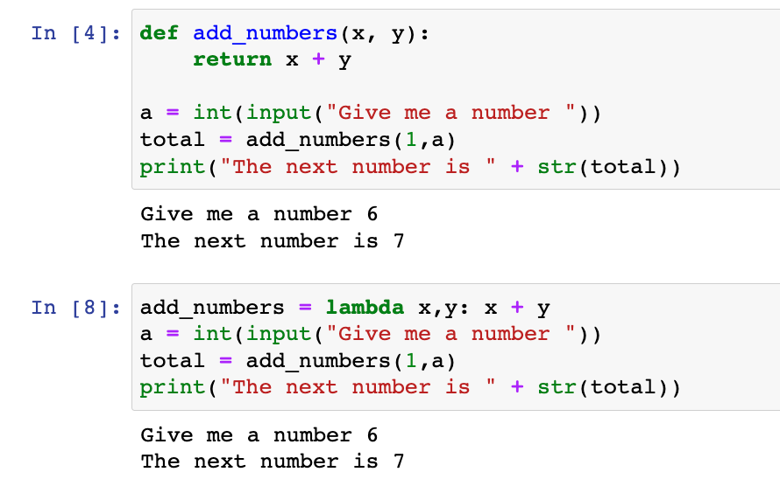
Lambda Functions
Formally, lambda functions are functions with no name
They are also known as anonymous functions

Slide 13
Lambda Functions
In python, we use the lambda keyword to define a lambda function
we store the function in a variable and use the variable to call the function

Slide 14
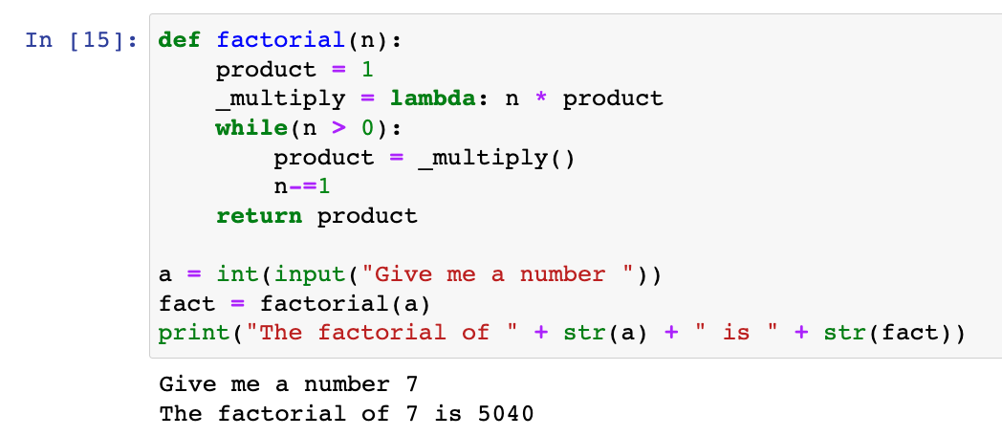
Why lambda functions?
Lambda functions are great when used inside other functions or a one-time operation

Slide 15
Why lambda functions?
We can use them to quickly create collections

